Slide 1
UI Change – Output – V1
May 28, 2017 Robin Wei

Slide 2
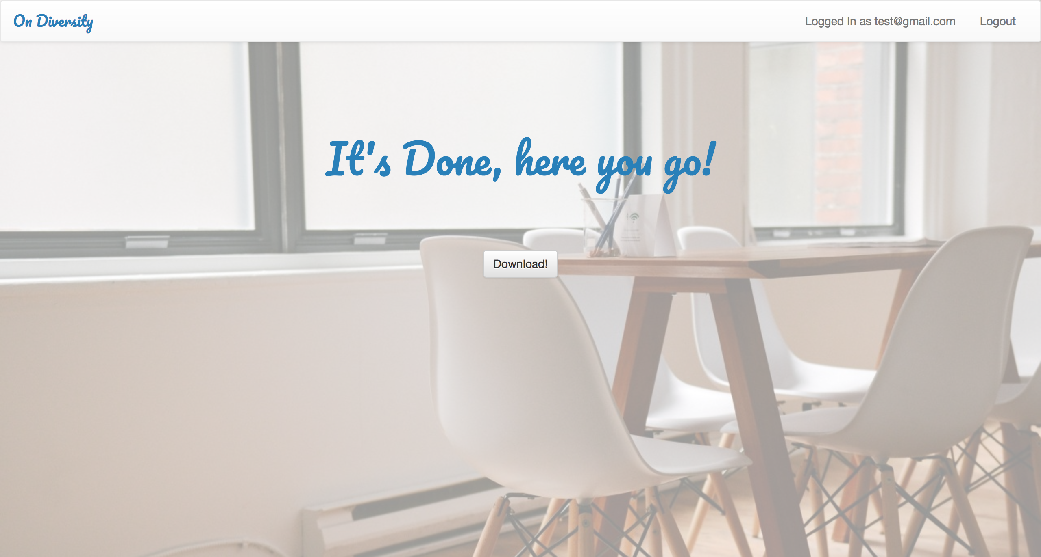
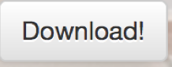
You can now download your grouped data
Or see the report
See report!
Decoration line

Slide 3
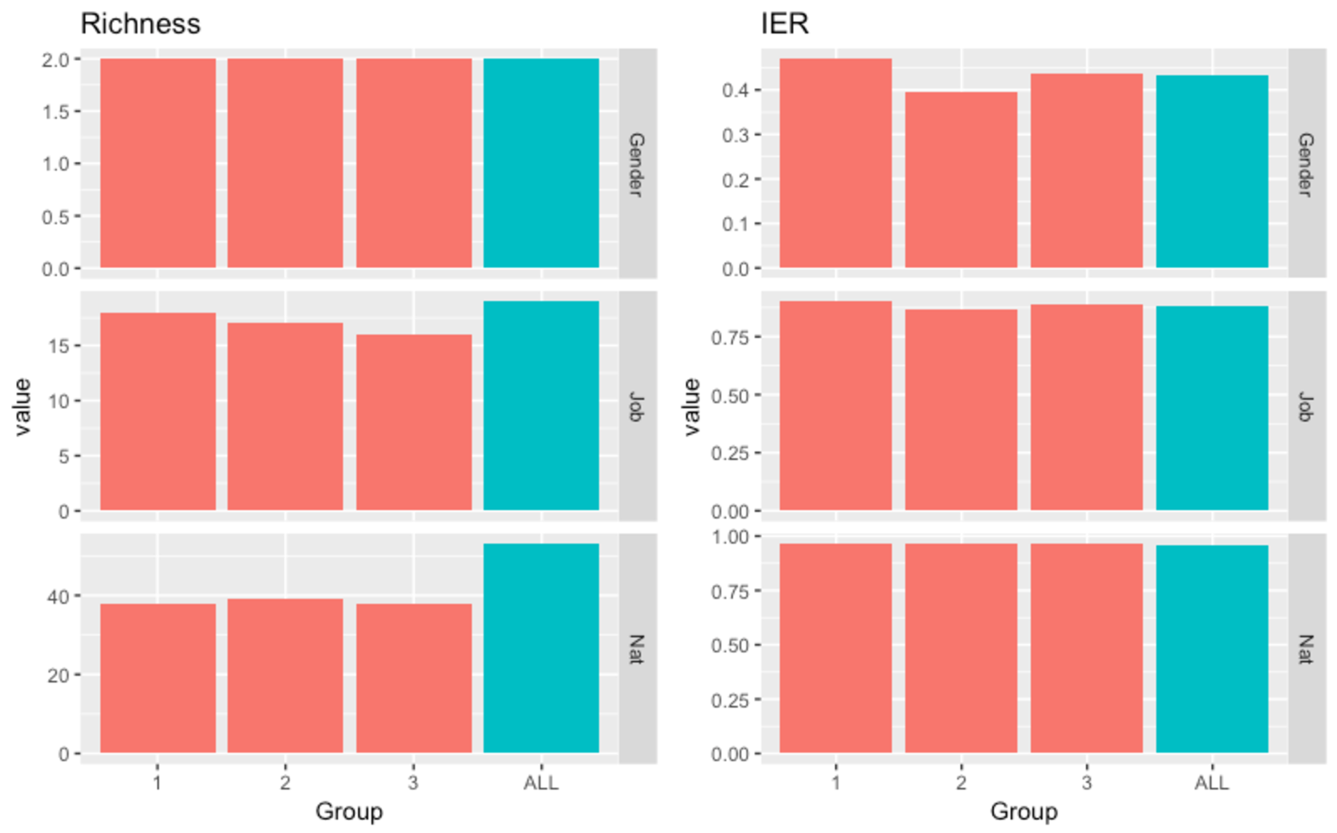
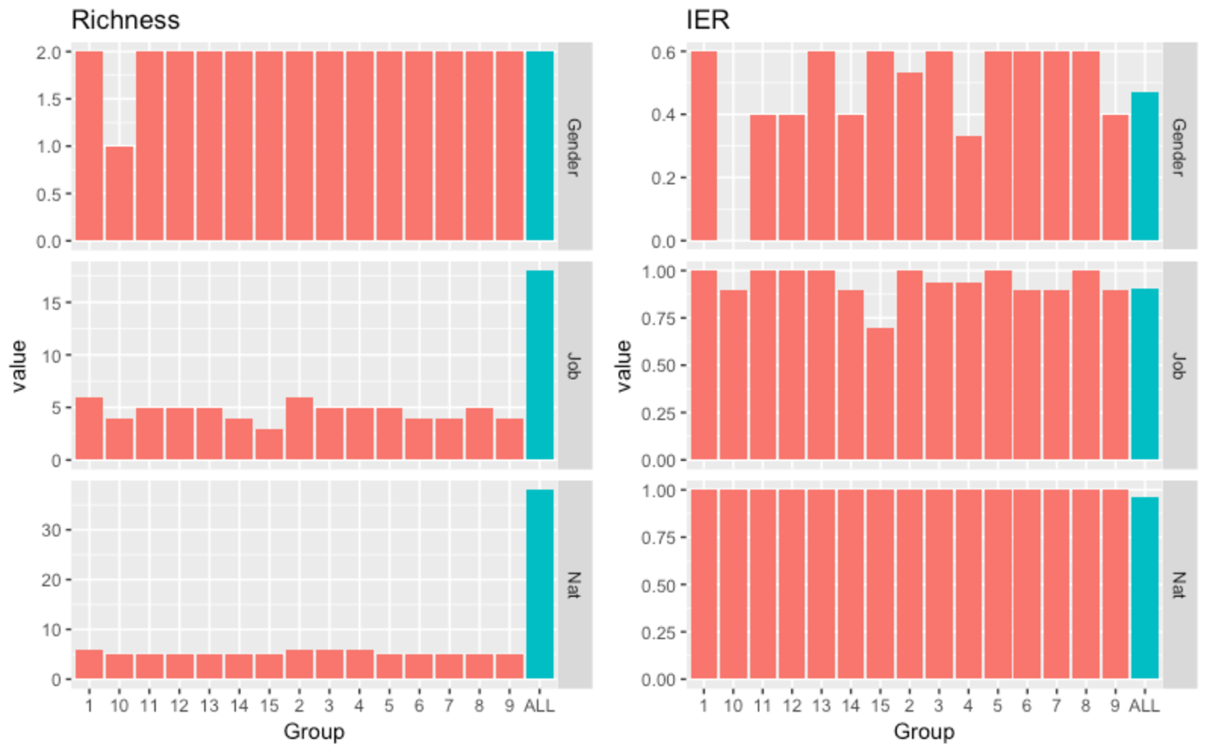
When press ”See report!”… Scroll down
See the diversity of each group compare to the original group.
Click or hover to enlarge the diagram…
Group:
Group_1_Study group:
Group_2_Study group:
Group_3_Study group:
There’s 3 groups, each has 15 Study groups. Therefore, there will be 3 reports on Study group.

